Slide 1
MPI-accelerated Bootstrap Resampling for Hypothesis Testing in Small Sample Investigation
Parallel Computing Final Report
M112040036 孫瑞鴻
M112040034 李祐瑄
2023-06-06

Slide 2
CONTENTS
Data
Bootstrap
MPI Application
Conclusion
Extra try — Remote

Slide 3
01
Data

Slide 4

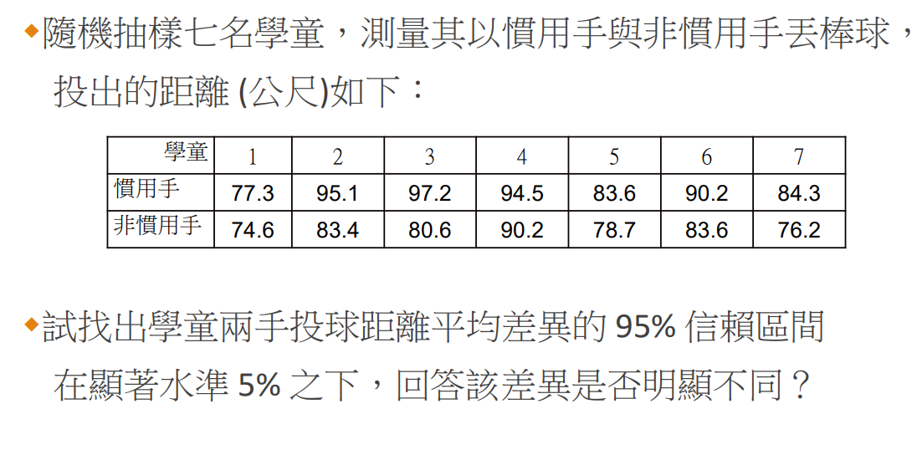
The data on throwing distances for dominant and non-dominant hand in pitching.
虛無假設:兩手投球距離無明顯差異
H0 = mean(X₁) - mean(X₂) = 0
source : STATISTICAL INFERENCE(NSYSU) w12_permutation test by ShengLi Tzeng

Slide 5
02
Bootstrap

Slide 6
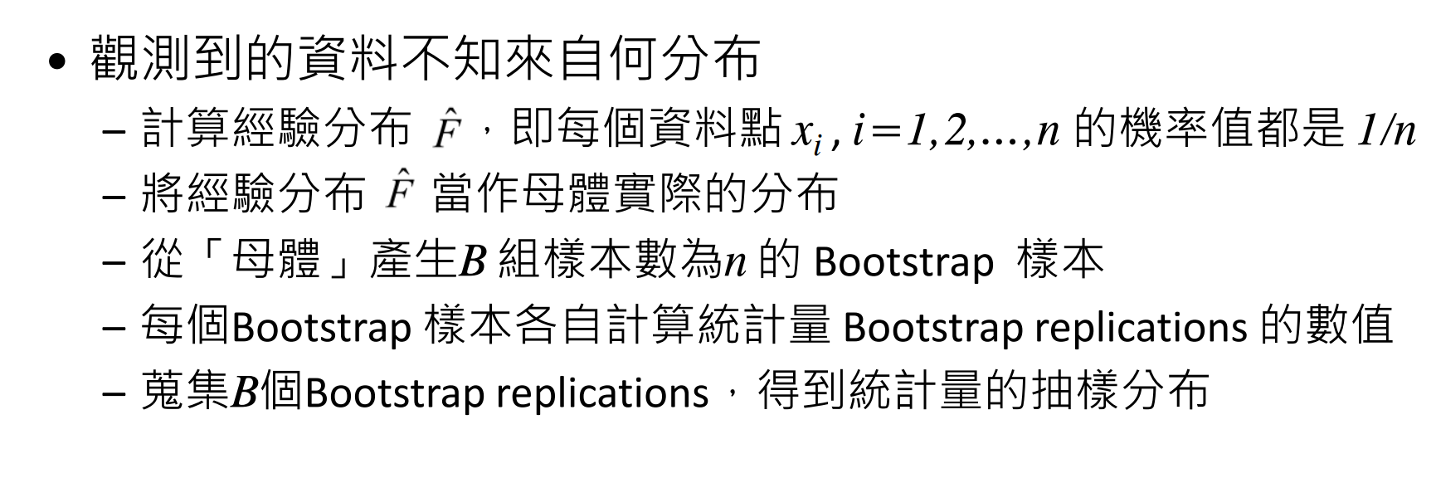
parametric Bootstrap
source : STATISTICAL INFERENCE(NSYSU) w06_simulation&inference by ShengLi Tzeng

Slide 7
03
MPI Application

Slide 8
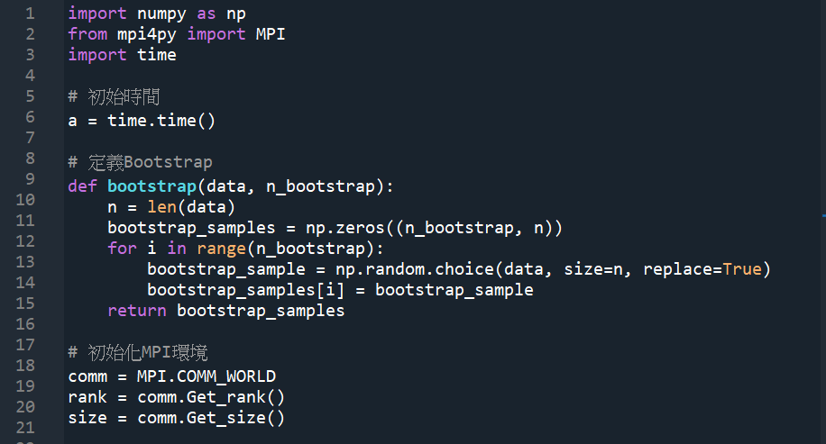
MPI Application

Slide 9
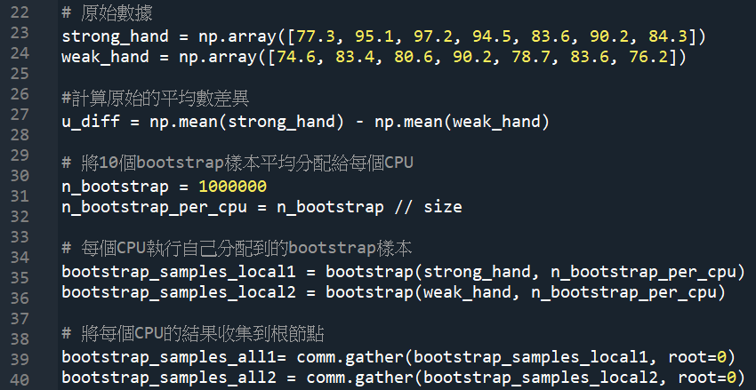
MPI Application

Slide 10
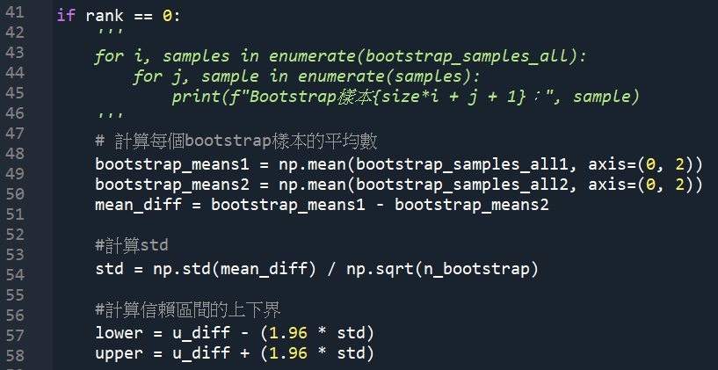
MPI Application

Slide 11
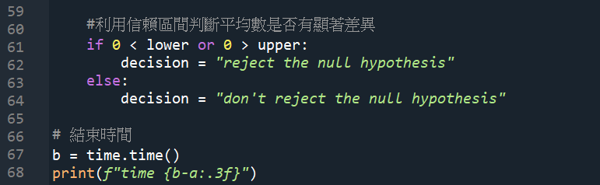
MPI Application

Slide 12
04
Conclusion

Slide 13
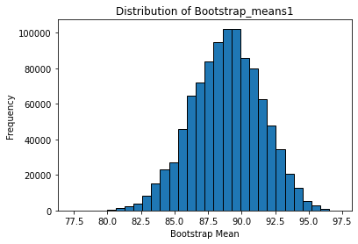
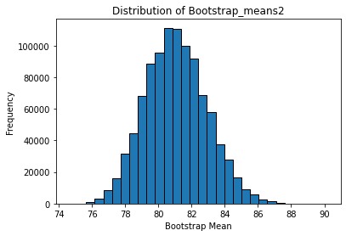
Conclusion

Slide 14
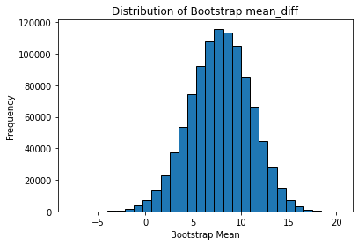
Conclusion
According to the Central Limit Theorem, it can be observed that the distribution approaches a normal distribution.

Slide 15

Conclusion
The confidence interval does not include zero, therefore the null hypothesis is rejected.

Slide 16
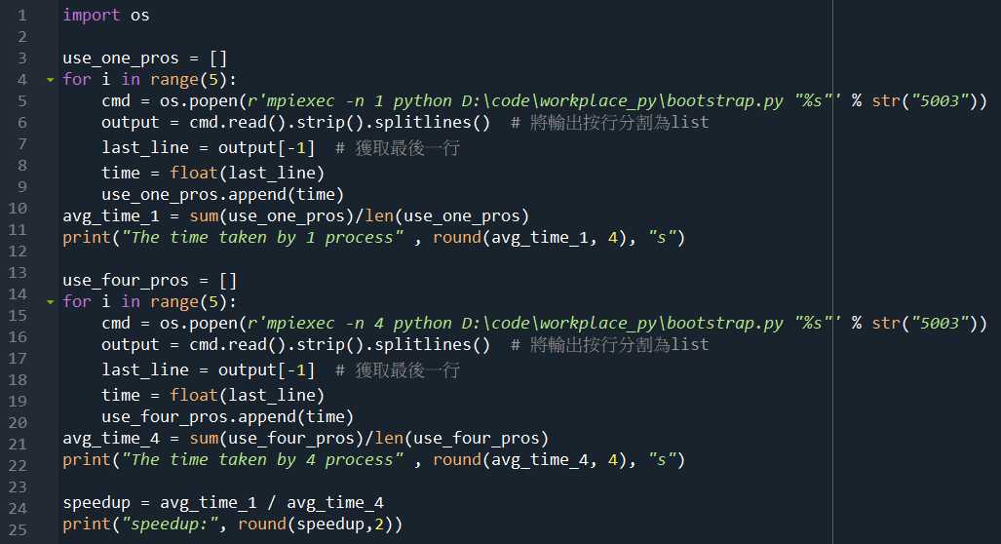
Conclusion

Slide 17

Conclusion
Speed up : The time taken by 1 process / The time taken by 4 process
The time taken by 1 process 25.8166 s
The time taken by 4 process 9.9266 s
speedup: 2.6

Slide 18
05
Extra try — Remote

Slide 19
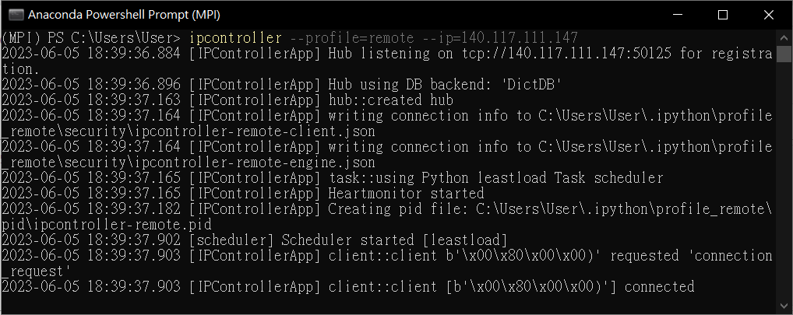
Extra try — Remote

Slide 20
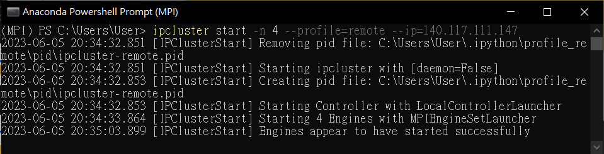
Extra try — Remote

Slide 21
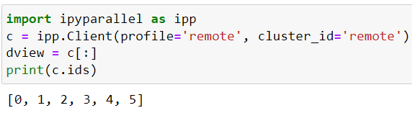
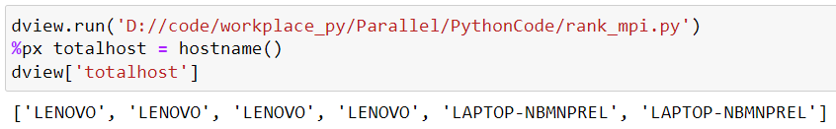
Extra try — Remote

Slide 22
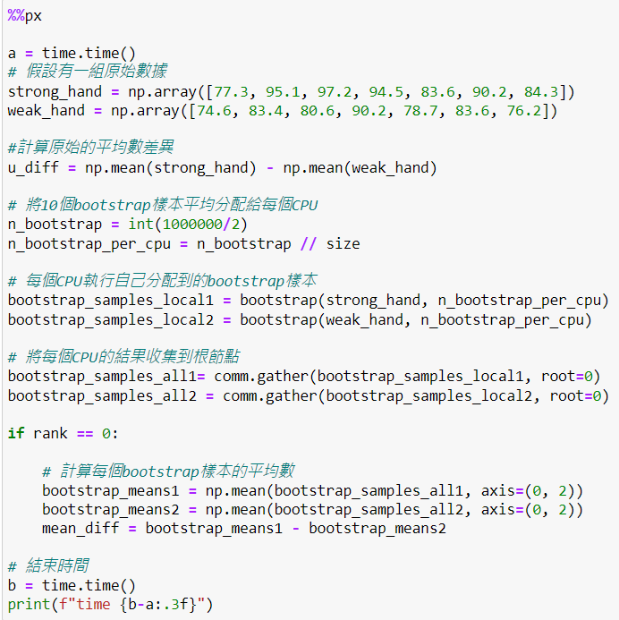
Extra try — Remote

Slide 23
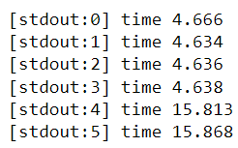
Extra try — Remote

Slide 24
THE END
THANKS

